Slide 1
Can IoT revolutionize health monitoring for asthmatic patients?
Real-time Monitoring of Respiratory Health Using Smart Sensors and Cloud Integration

Slide 2

What Problem Are We Solving?
Respiratory diseases are a major health concern globally
Manual health monitoring is inconvenient and often delayed
Lack of affordable, continuous remote monitoring solutions
Early signs like cough patterns and vitals often missed

Slide 3

What’s Our Answer?
IoT device detects cough, heart rate, SpO₂, temperature, humidity, air quality
Combines sound and tilt sensors for accurate cough detection
Sends real-time data and alerts to cloud (Firebase)

Slide 4
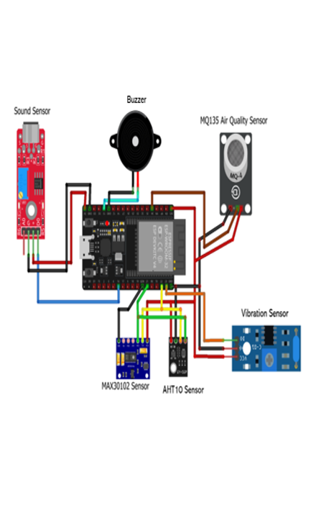
How Does It All Work Together?
ESP32 microcontroller as main processor
Sensors: Sound sensor, Tilt sensor, MAX30105, AHT10, Air quality sensor
Data flow: Sensors → ESP32 → Firebase Cloud → User Interface

Slide 5

What Makes Our System Smart?
Real-time cough detection with pattern analysis
Continuous heart rate and SpO₂ monitoring
Temperature, humidity, and air quality sensing
Cloud integration for remote alerts
Buzzer alerts on dangerous cough patterns

Slide 6

Why Now? Why Us?
Respiratory diseases are a major health concern globally Growing demand for remote health monitoring
Increased focus on respiratory health post-COVID
Target users: Hospitals, elderly care, home health, fitness market

Slide 7

What Sets Us Apart?
Multi-sensor integration in one device
Accurate cough detection using dual sensors
Real-time cloud monitoring and alerts
Portable, easy-to-use, affordable

Slide 8

How Will We Grow?
Device sales to hospitals and consumers
Subscription for cloud data and alert services
Analytics and reports for health providers
Partnerships with healthcare companies

Slide 9

Can IoT Improve Asthma Care?
Real-time, affordable health monitoring for asthmatic patients
Early detection of cough and vital sign abnormalities
Cloud alerts improve response times
Smarter monitoring = better health outcomes

Slide 10
Thank You!
- A Project By Group 03 -

